Slide 1



Medical diagnosis & hospital management
Course Based Project
Java Programming
Team members:
Daram Santosh
Harsha
Eshwar
Sohan
Vineeth

Slide 2



Objectives
To master the application of java concepts in real life applications.
To provide 24/7 medical services online with no human error.

Slide 3




To ease the managing of patient records by using advanced data structures
To analyze the health condition through the use of advanced data structures.

Slide 4

Features
Store the medical records of the
patient till data in date wise order.
Use the historical records in diagnosis algorithms to provide medication.
Use the medical records of other patients also, to provide high accurate health predictions of future and better prevention medication.
To reserve berth in hospital when the severity of diseases is high. Also, as the hospital has limited seats, we also manage berth allocation.

Slide 5

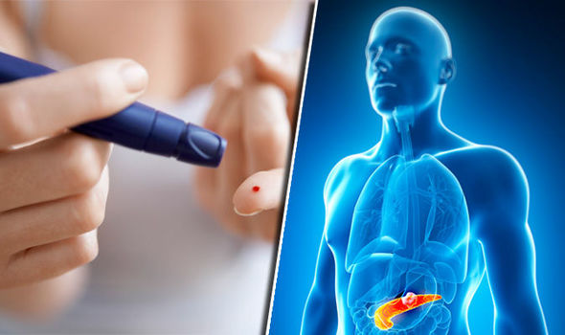
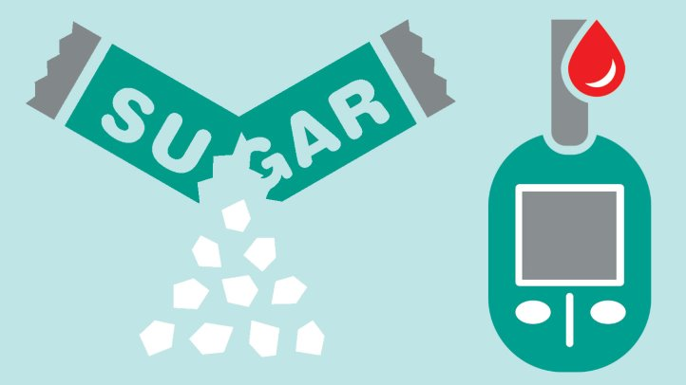
Example: Identification of diabetes (through symptoms):
Frequency of urination and range of thirst
Tiredness
Blurred vision
4. Obesity(Body Mass Index(BMI Ratio)) etc.

Slide 6
Concepts involved
Use object patient to store the patient data.
Use file to store data of previous patients in the form of objects.
Use weighted symptoms for predicting the percentage of severity of disease.
Based on severity of disease, giving health tips and medication.
Use user define exception to throw an exception when no free berths are available for patients who suffering severely from diseases.

Slide 7
Implementation(Algorithm)
Step 1:Display the following menu:
1.New customer
2.Old customer
Enter your choice
1.On pressing '1', we will ask for the patients id and phone no. And on successful log in display:
"Hello {Name in the stored object}"
2.On pressing '2', we will ask for the following details to create a new object:
Name, Phone no., Gender, Age, Blood group, Address etc.

Slide 8
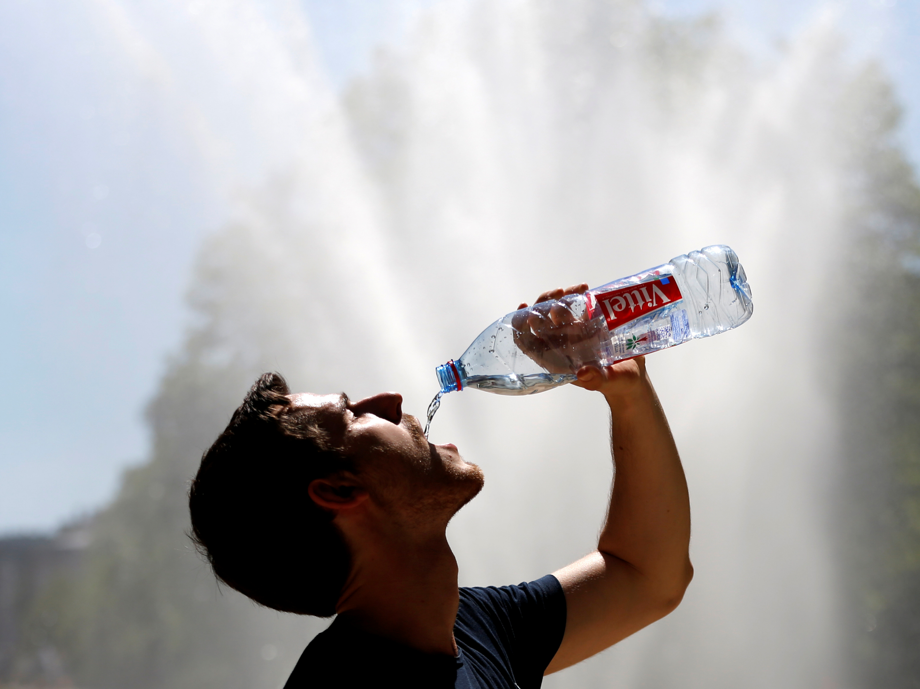
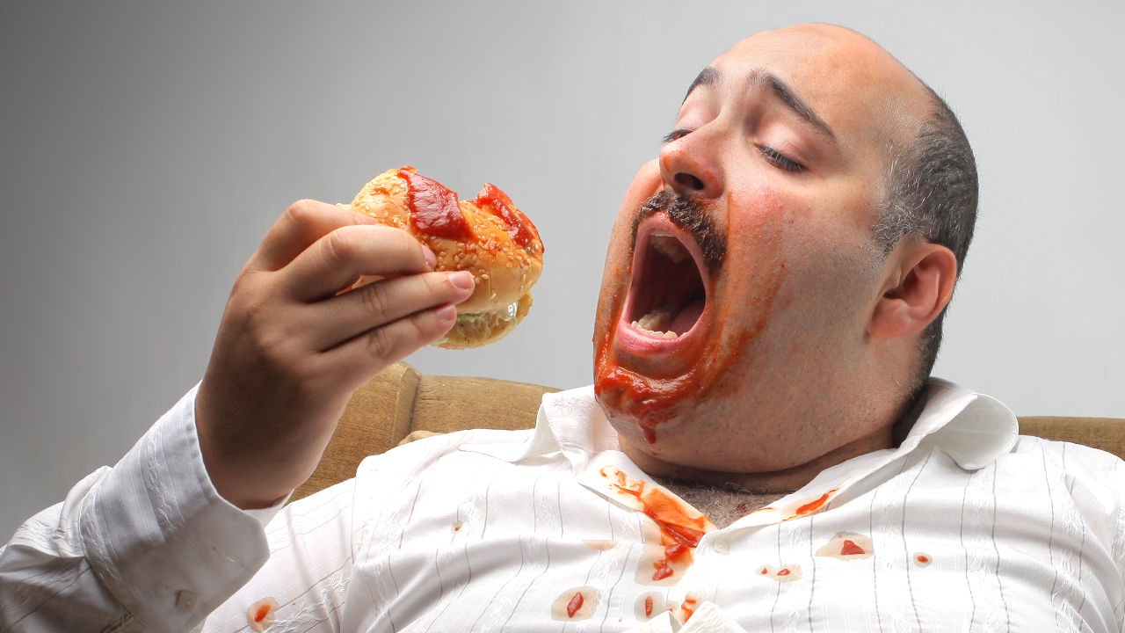
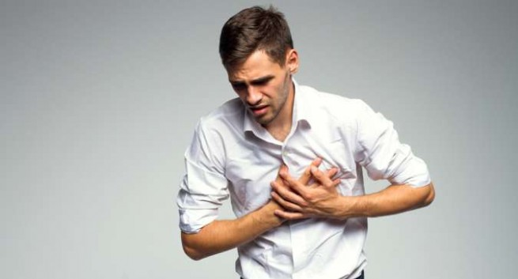
Step 2:Ask for the severity of following symptoms and habits in the range 0-5:
1.Frequency of thirst
2.Frequency of urination
3.Frequency of hunger
4.Chest pain

Slide 9

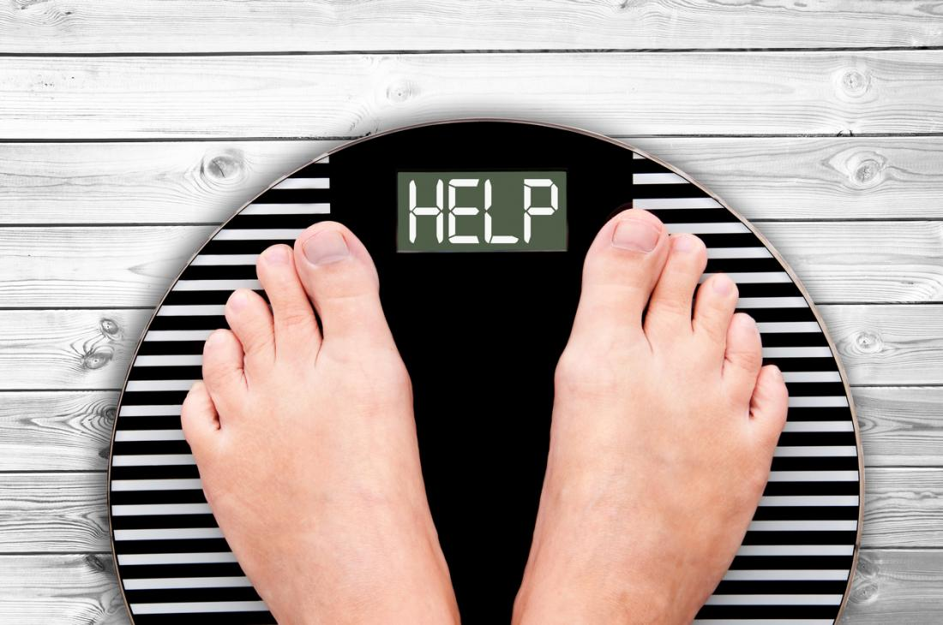


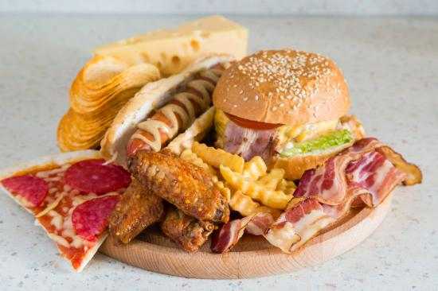
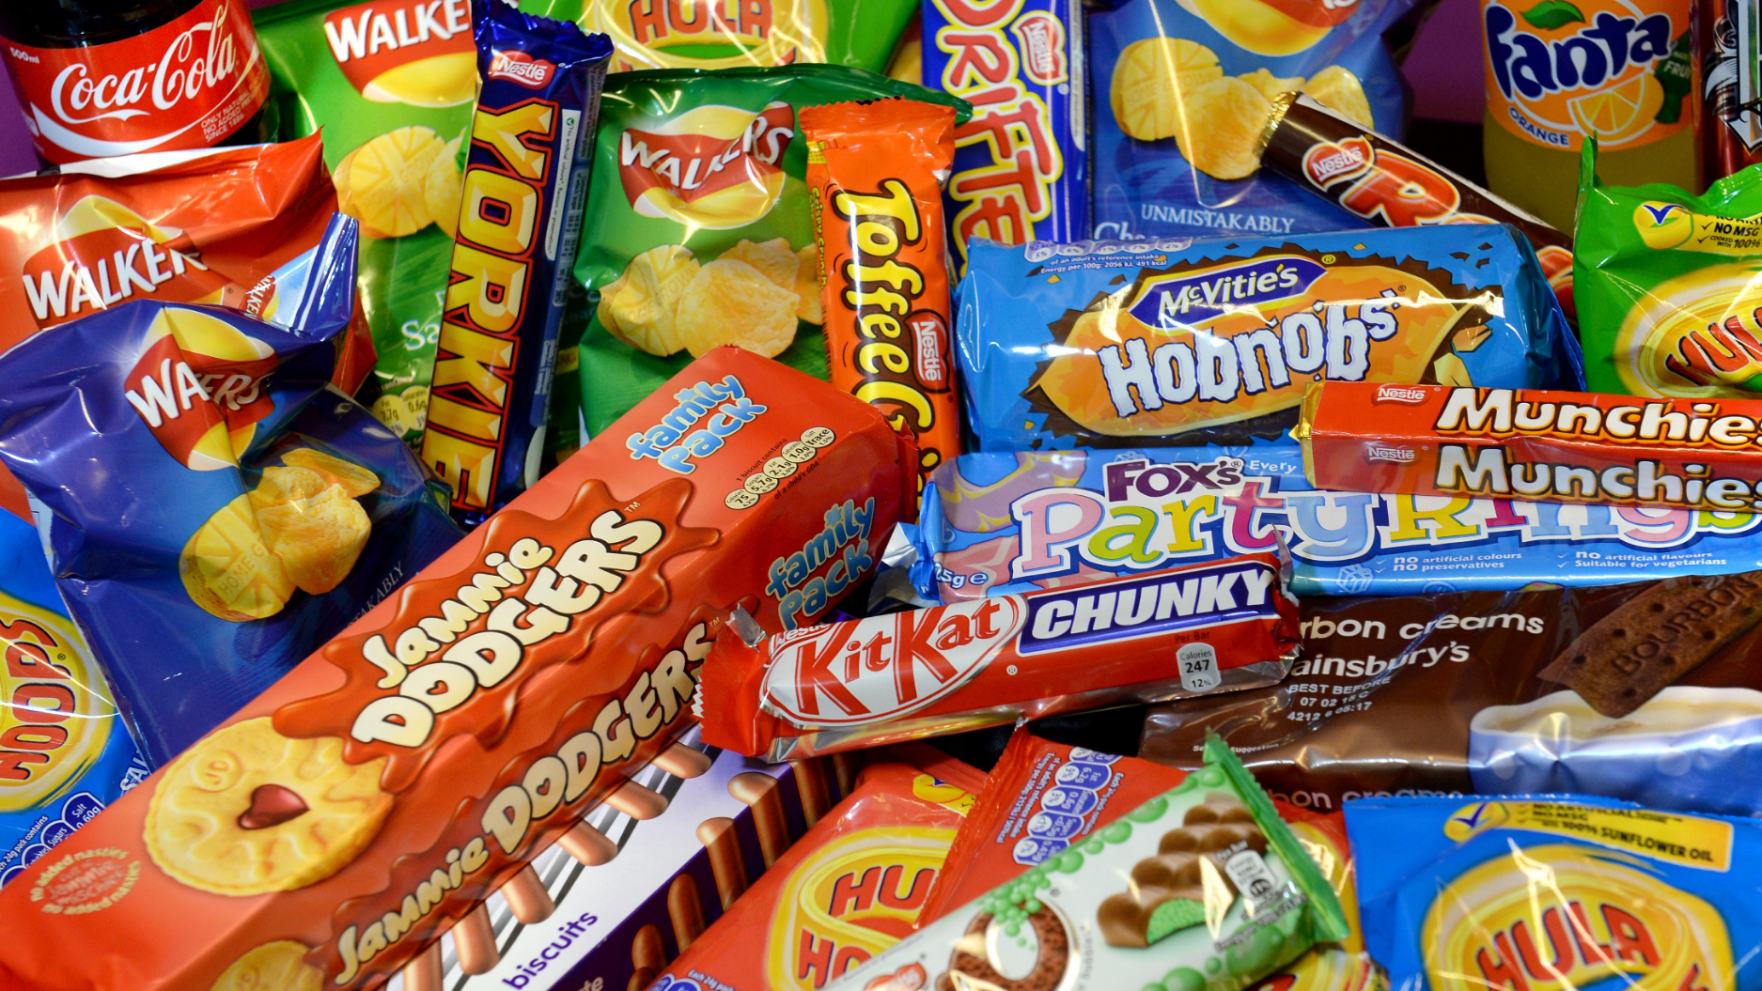
5.Tiredness
6.Obesity
7.Smoking and alcohol consumption
8.Lack of exercise
9.Blureed vision
10.Junk food
11.Urine color

Slide 10
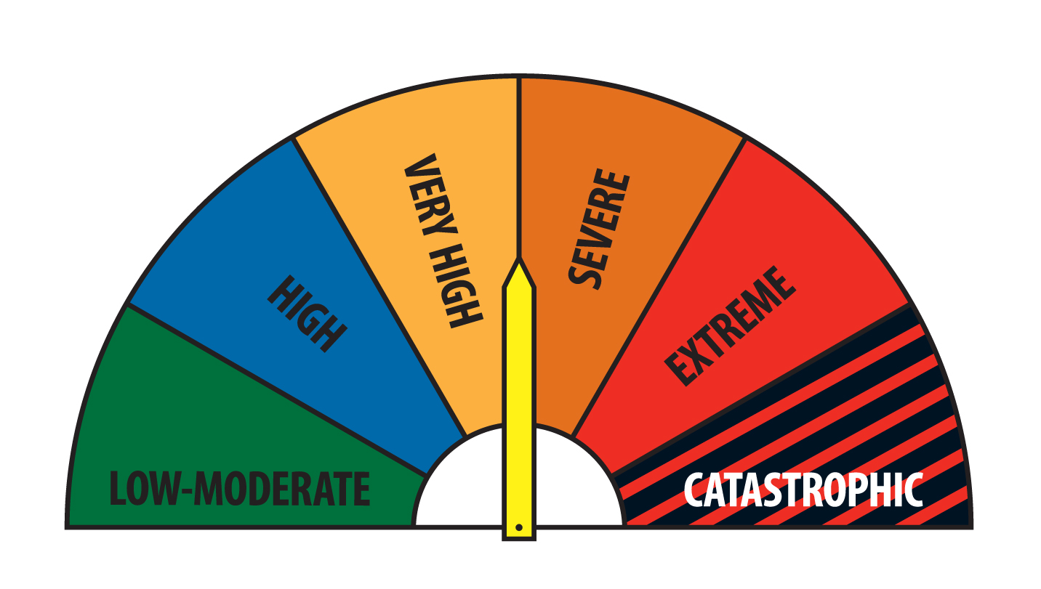


Step 3:Based on the given data use severity predictors for deadly diseases like tuberculosis, heart stroke, liver damage, diabetes 1 and 2 etc.
Based on severity and bad habits give health tips and medication.

Slide 11
Example case
New patient
Name: abcd
Phone no.: 999 999 999
Gender: M
Age: 56
Blood group: O+
Address: Vijaypuri colony, Kothapet, Hyderabad

Slide 12
Symptoms:
1.Frequency of thirst: 5
2.Frequency of urination: 5
3.Frequency of hunger: 4
4.Tiredness: 3
5.Blurred vision: 4
6.Junk food: 3
7.Lack of exercise: 4
Output:
Diabetes 1: Severity 85 percent
Diabetes 2: Severity 89 percent

Slide 13
Health tips:
1.Do at least 1 hour of exercise daily.
2.Eat balanced nutritious diet.
3.Avoid junk food at all consequences.
Medication:
1.Insulin therapy
2.Metformin
3.Giltazones
4.SGLT-2
Hospitalization suggested.
Press 1 to book berth or 0 to skip.
1
Berth successfully booked.

Slide 14


